Slide 1


Slide 2

STARTER – DAY 2

Slide 3
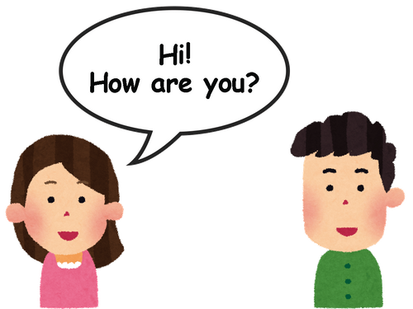
Hello!
I’m fine, thanks.
And you?

Slide 4
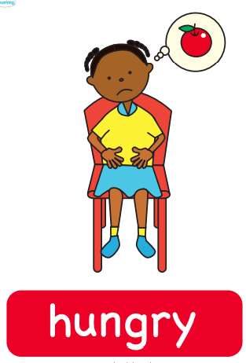
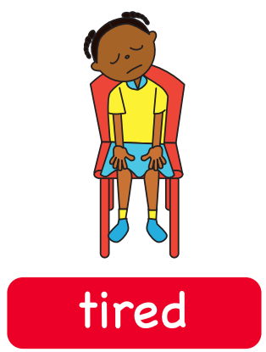
I’m...

Slide 5


I’m...

Slide 6
Let’s play STOP!

Slide 7
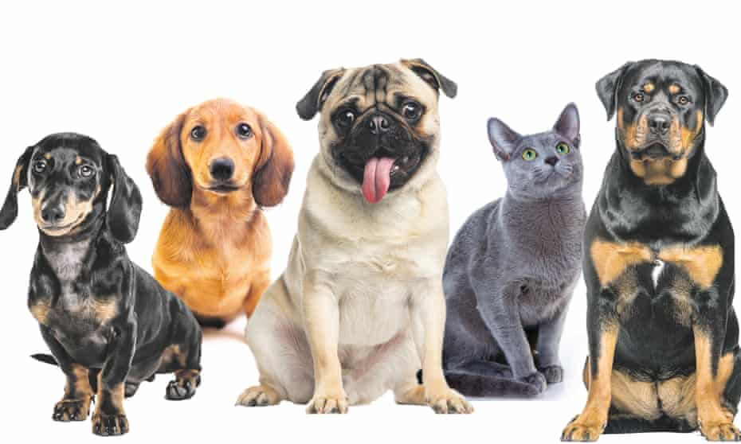
ANIMALS

Slide 8

COLORS

Slide 9


Slide 10
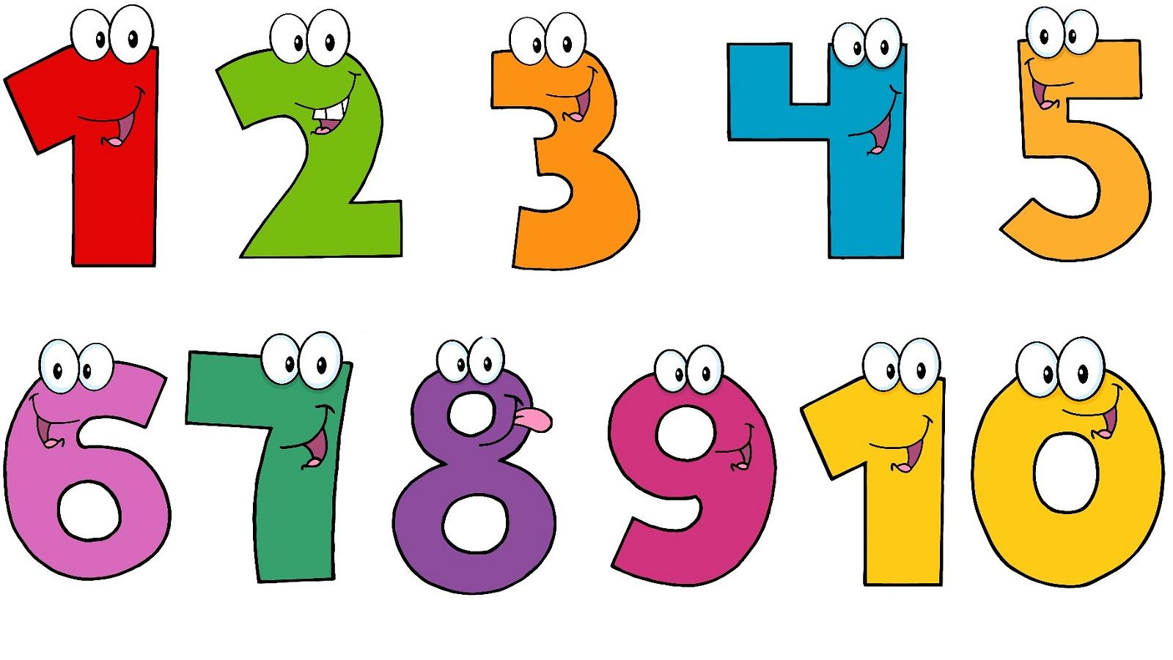
NUMBERS

Slide 11
Course Information

Slide 12
Using Microsoft Teams

Slide 13
Calendar

Slide 14
Exams
Each cycle includes:​
​
- Paper tests (10,0)​
Structure​
Reading​
Listening​
Writing​
- Oral test (10,0)​
- Class evaluation (10,0)​
Objective (Assignemnts)​
Subjective (Expression, Interaction and Development)
3 Cycles of exams;
Avarage grade: 7,0;
2nd call tests;
Absence limit!!!
25% of total hours.
In case you can’t watch the LIVE class, remember to watch the recording!

Slide 15
How can I do well in class?

Slide 16
Use your camera, microphone and chat.

Slide 17
Respect class time. ⏰

Slide 18
Participate!!

Slide 19
Speak English , Don’t translate!!!

Slide 20

FOCUS!!

Slide 21
IMPORTANT EXPRESSIONS

Slide 22


